Slide 1
sales analysis
GameCo
Task 10- Final
Project Presentation
Euikyu Kim
July 9th, 2023
Budget Planning for 2017

Slide 2
Contents
FACTS
What’s in data?
Is global sales stayed the same over time?
REASON
SUGGESTION

Slide 3
Facts
What’s in data?

Slide 4
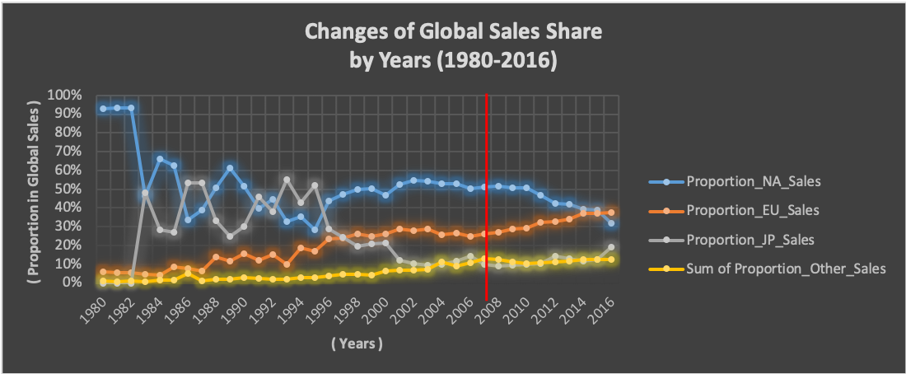
Sales in ‘NA’ and ‘Japan’ flows very oppositely.
Sales in the ‘EU’ and ‘Other’ have steadily risen, albeit slightly. (EU > Other)
Sales in 'EU' overtook 'NA' for the first time since 1980, the first year of this dataset.
‘NA’s global share ranges from 28% (1995) to 93% (1980-81).

Slide 5
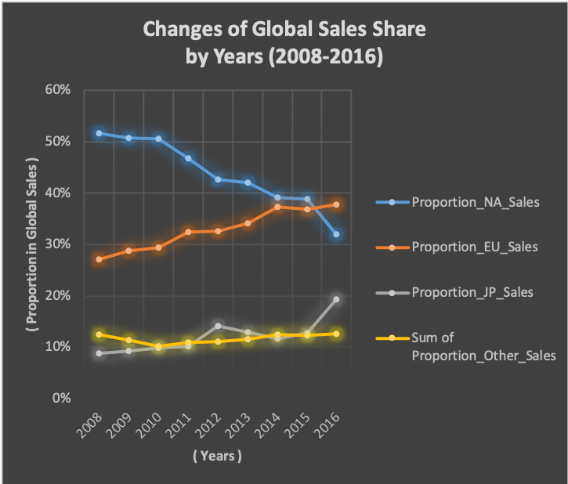
Close up to 2008-2016
While sales in 'NA' falls…
'EU,' 'Japan,' and 'Other' are edging up.
In 2015, the 'EU' overtook 'NA' in sales.

Slide 6
Keypoint
Since 2008, sales in…
'NA’ is declining,
'EU,' 'Japan,' and 'Other' are increasing.
As of October 2016, global share in sales is as follows.
'EU’- 38%
'NA’- 32%
'Japan’- 19%
'Other’- 13%
38%
32%
19%
13%

Slide 7
Facts
Is global sales stayed the same over time?

Slide 8
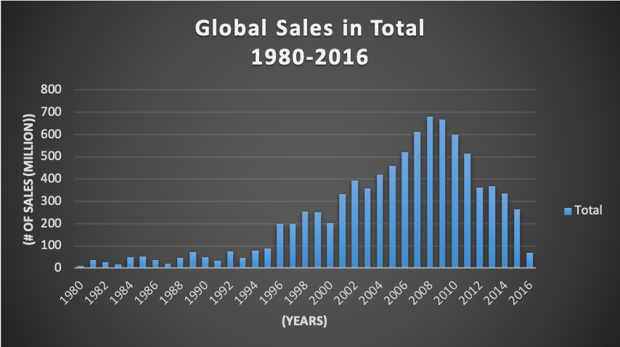
Global sales have fallen sharply since 2008 till now, October 2016.

Slide 9
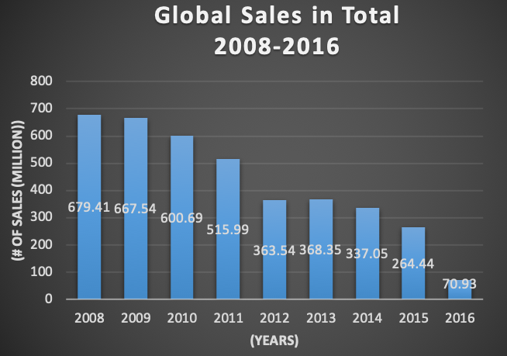
Close up to 2008-2016
Compared to the year 2008, the peak of global sales, it fell 9.6 times this year, 2016.
Compared to last year, 2015, it fell 3.7 times this year, 2016. (This is the deepest annual fall.)

Slide 10
Facts
Is global sales stayed the same over time?
“No! Global sales is declining especially in North America region!”

Slide 11
Reason
Why?

Slide 12
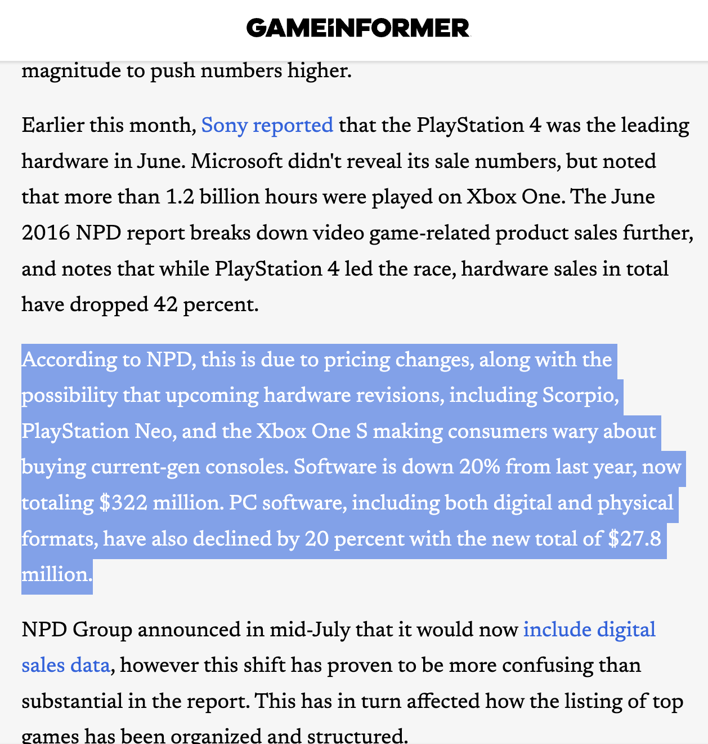
Why?
”…this is due to pricing changes, along with the possibility that upcoming hardware revisions, including Scorpio, PlayStation Neo, and the Xbox One S making consumers wary about buying current-gen consoles…”
- From the article "June 2016 NPD: Video Game Sales Shoot Downward, Overwatch Is June's Top Game” by Elise Favis at ‘Game Informer’

Slide 13
Suggestion
Opportunity

Slide 14
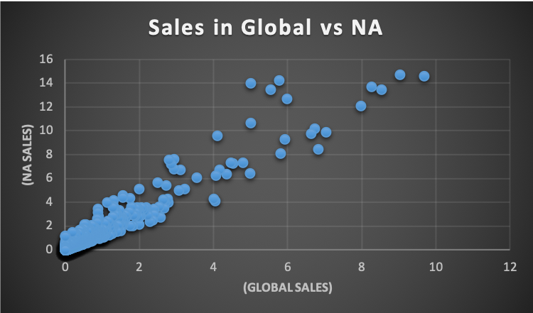
Opportunity
Sales in 'NA' and the Global has a strong positive correlation.

Slide 15
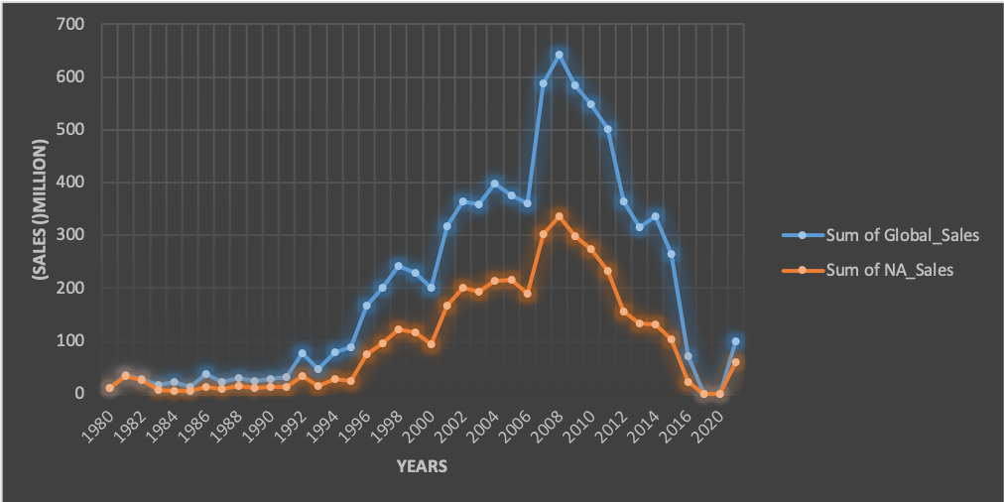
Opportunity
'NA' sales accounts for a large portion of the Global sales.

Slide 16
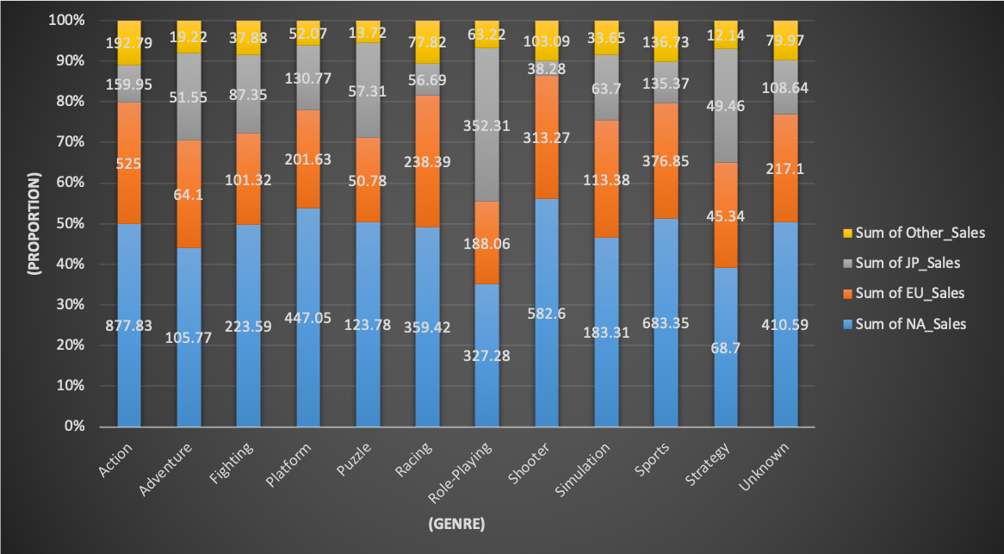
In many genres, ‘NA’ has the biggest market share among other region. such as Platforms, Shooters, and Sports.

Slide 17
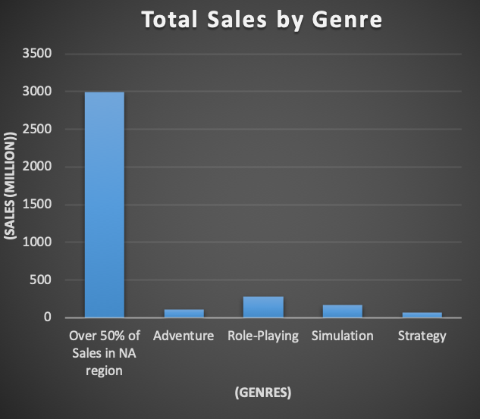
OPPOTUNITY
Genres such as Action, Fighting, Platform, Puzzle, Racing, Shooter, and Sports account for more than 50%, respectively, of global sales in NA.
The share of the group of these 7 genres is overwhelming.

Slide 18
Suggestion
Europe: Steadily rising in sales for over 30 years.
North America: Still accounts for a large portion of global sales.
Managing genres and prices that are strong by region.

Slide 19
Thank You!

